Slide 1
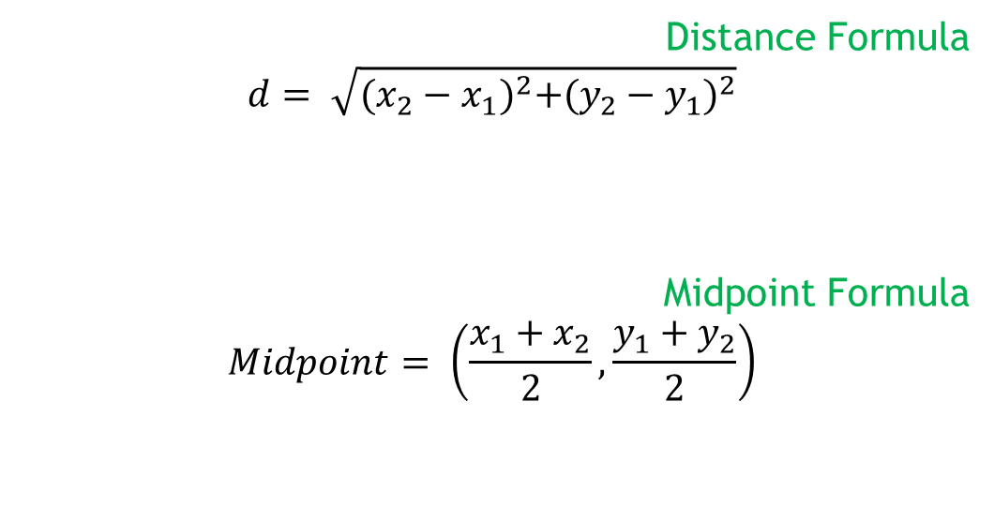
Unit 1 -Functions and Their Graphs
Section 1.1
Distance Formula
$$d= \sqrt{{(x_{2}−x_{1})}^{2}+{(y_{2}−y_{1})}^{2}}$$
Midpoint Formula
$$Midpoint= \left(\frac{x_{1}+x_{2}}{2},\frac{y_{1}+y_{2}}{2}\right)$$

Slide 2
Coordinate Plane
Name:
1. 4 Quadrants
2. x and y-axis
3. positive and negative in quad
4. origin

Slide 3
Coordinate Geometry
If ∆HLM has vertices H(-3, 2), L (2, 1) and M (3, 6).
Show that the triangle is a right, isosceles triangle.

Slide 4
If Quad ABCD has vertices A (-3, -1), B (-6, 2), C (-2, 6), and D (1, 3), show the diagonals bisect each other and are congruent. What is the most specific name for quad ABCD?

Slide 5

Section 1.2
Write a linear equation given the following information.
m = $\frac{1}{2}$ and b = -1
2. m = undefined and through (1, -2)

Slide 6

3. through the point (-1, 3) and m = $\frac{1}{2}$

Slide 7
4. through the points (5, 1) and (2, 7)

Slide 8
5. x-intercept of 3 and a y-intercept of -2

Slide 9

6. y-intercept of -1 and $⊥$ to 3x – 2y = 4

Slide 10
7. through (1, -4) and || to 2x – y = 4

Slide 11
8. the perpendicular bisector of the segment joining the points (7, 0) and ( 1, 8)

Slide 12
A triangle is located at the vertices R (2, 2),
S (5, 5), and T (7, 1).
A. Find the equation of the median from R.
B. Find the equation of the altitude from T.

Slide 13
10. A triangle has the vertices A(-3, 2), B(-2, -1), and
C(4, 1).
A. Find the equation of the median from A.
B. Find the equation of the altitude from C.

Slide 14
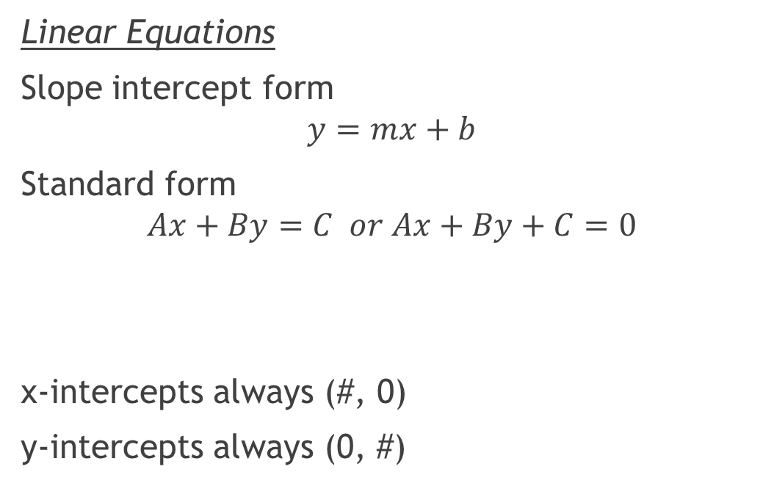
Section 1.3
Linear Equations
Slope intercept form
$$y=mx+b$$
Standard form
$$Ax+By=C or Ax+By+C=0$$
x-intercepts always (#, 0)
y-intercepts always (0, #)

Slide 15

Important shapes to know
Parabola
$$y= {\left(x−h\right)}^{2}+k$$
Circle
$${\left(x−h\right)}^{2}+{\left(y−k\right)}^{2}= r^{2}$$

Slide 16
The point (-3, -5) lies on a circle whose center is (1, -2). Find the equation of the circle in standard form.

Slide 17
p9. #11-20, 24, 26, (32-38 evens), 41, 42
p.22 #7, (10-20 evens), (33, 34, 35 graph only), 59, 62, 67
p.36 #89, 90
p.39 #129-132

